Slide 1
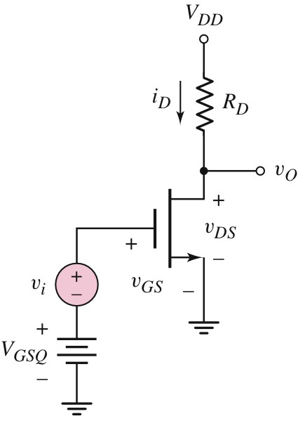
MOSFET
Basic FET Amplifiers
The MOSFET Amplifier
The figure shows a basic MOSFET amplifier where the dc source V_{GSQ} is used to provide the bias voltage between gate and source.
The ac voltage source v_{i} which represents the signal source is connected in series with the bias voltage V_{GSQ}.

Slide 2
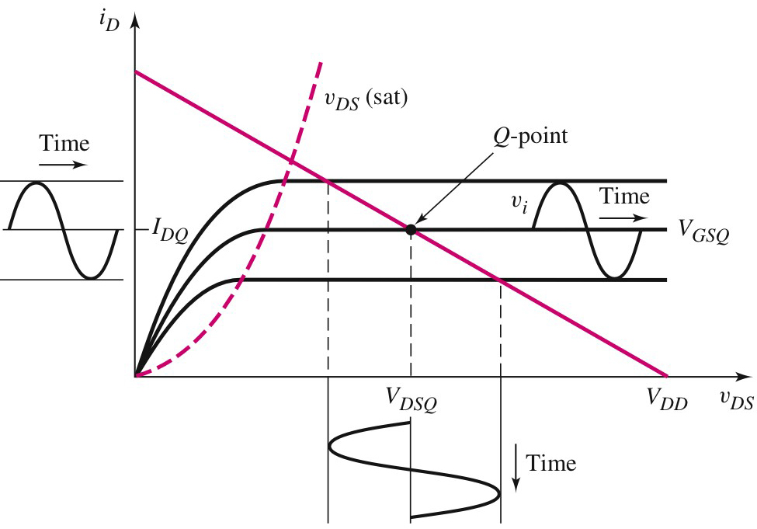
MOSFET
Basic FET Amplifiers
The MOSFET Amplifier
The figure shows the corresponding characteristic, load line and Q-point for the amplifier.

Slide 3
MOSFET
Basic FET Amplifiers
The MOSFET Amplifier
The Q-point is on dc load line and Q-point are functions of v_{GS}, V_{DD} and R_{D} and the transistor parameters.

Slide 4
MOSFET
Basic FET Amplifiers
The MOSFET Amplifier
The sinusoidal input voltage (v_{i}) causes variations in the gate-to-source voltage (v_{GS}), drain current (i_{D}) and drain-to-source voltage (v_{DS}).
Sinusoidal input voltage (v_{i})
Sinusoidal variation in the drain current (i_{D})
Sinusoidal variation in the drain-to-source voltage (v_{DS})

Slide 5
MOSFET
Basic FET Amplifiers
The MOSFET Amplifier
The total v_{GS} is the sum of V_{GSQ} and v_{i} i.e;
As v_{i} increases, the instantaneous value of v_{GS} increases, and the bias point moves up on the load line.

Slide 6
MOSFET
Basic FET Amplifiers
The MOSFET Amplifier
Larger value of v_{GS} means larger drain currrent i_{D} and smaller value of v_{DS}.
The negative swing of v_{i} causes v_{GS} to decrease below the quiescent value, and the bias point moves down the load line.

Slide 7
MOSFET
Basic FET Amplifiers
The MOSFET Amplifier
A smaller value of v_{GS} means smaller drain current i_{D} and larger value of v_{DS}.
Thus this configuration causes phase inversion.

Slide 8
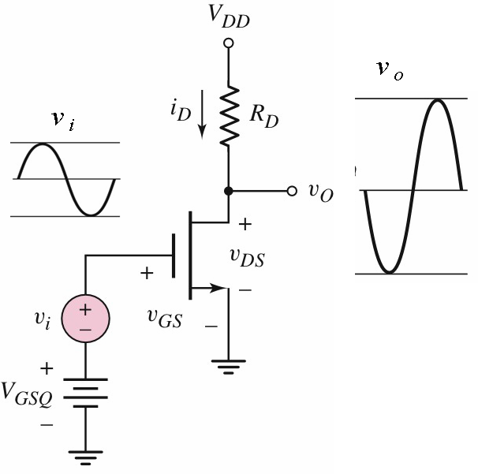
MOSFET
Basic FET Amplifiers
The MOSFET Amplifier
Phase inversion between input and output voltages

Slide 9
MOSFET
Basic FET Amplifiers
The MOSFET Amplifier
For the MOSFET to operate as a linear amplifier, it must be biased in the saturation region and the instantaneous drain current and drain-to-source voltage must also be confined to this region.

Slide 10
MOSFET
Basic FET Amplifiers
The MOSFET Amplifier
As long as the amplifier operates in the linear region, symmetrical input signal will produce symmetrical output.
If the limit is exceeded, the output signal will be clipped and distortion will occur

Slide 11
MOSFET
Basic FET Amplifiers
The MOSFET Amplifier
The total instantaneous value of the gate-to-source voltage is given by;
Considering only ac component;
Hence;
dc component
ac component

Slide 12
MOSFET
Basic FET Amplifiers
The MOSFET Amplifier
The total instantaneous drain current is;
Substituting for v_{GS};
or

Slide 13
MOSFET
Basic FET Amplifiers
The MOSFET Amplifier
The term is the dc component of the drain current
The term is the time-varying component of the drain current which is linearly related to the input signal v_{gs}.
The term is the component of the drain current which is proportional to the square of the input signal v_{gs}.

Slide 14
MOSFET
Basic FET Amplifiers
The MOSFET Amplifier
The term produces undesirable harmonics or non-linear distortion in the output voltage.
To minimize these harmonics, we must have;
This is the small-signal condition that must be satisfied for linear amplifier.

Slide 15
MOSFET
Basic FET Amplifiers
The MOSFET Amplifier
If the small-signal condition is satisfied, the term containing v_{gs}² may be neglected and the equation for i_{D} becomes;
The equation may be written as;
where;
− the dc component

Slide 16
MOSFET
Basic FET Amplifiers
The MOSFET Amplifier
and;
− the ac or signal component
From the above equation, we can write;
− the transconductance relating the output current to the input voltage

Slide 17
MOSFET
Basic FET Amplifiers
The MOSFET Amplifier
The transconductance can also be written as;
which gives us;

Slide 18
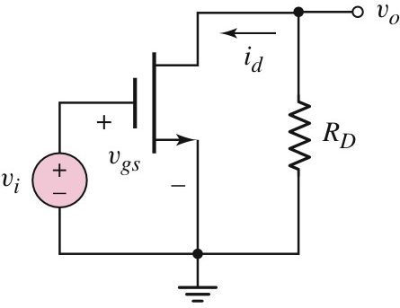
MOSFET
Basic FET Amplifiers
The MOSFET Amplifier
AC Equivalent Circuit
In the ac equivalent circuit, all dc sources are set to zero and V_{DD} is considered to be at signal ground.

Slide 19
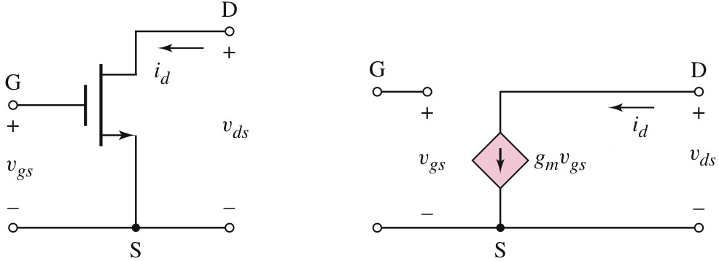
MOSFET
Basic FET Amplifiers
The MOSFET Amplifier
Small-signal Equivalent Circuit
If we neglect the effect of the output resistance r_{o}, the MOSFET and its small-signal equivalent circuit are as follows (in terms of instantaneous ac values):

Slide 20
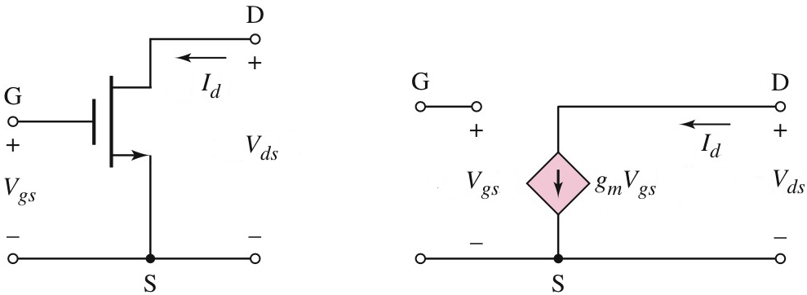
MOSFET
Basic FET Amplifiers
The MOSFET Amplifier
Small-signal Equivalent Circuit
The small-signal equivalent circuit in terms of phasor components (note the notation used):

Slide 21
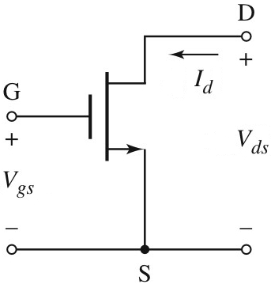
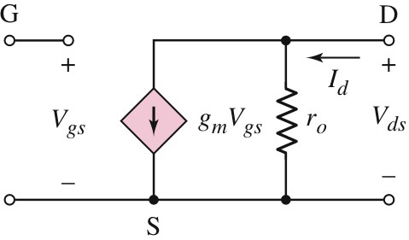
MOSFET
Basic FET Amplifiers
The MOSFET Amplifier
Small-signal Equivalent Circuit
The small-signal equivalent circuit with r_{o} taken into account.

Slide 22


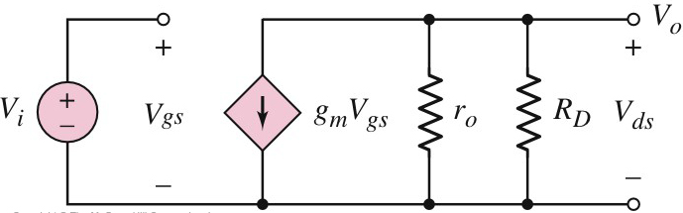
MOSFET
Basic FET Amplifiers
The MOSFET Amplifier
Small-signal Equivalent Circuit

Slide 23
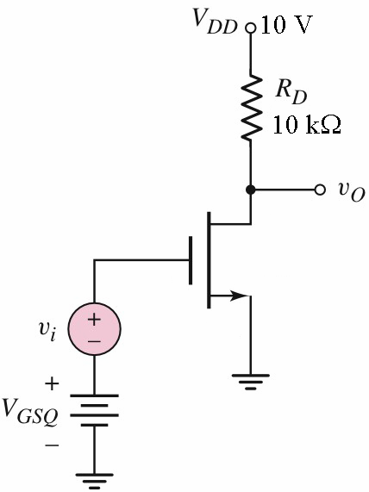
MOSFET
Basic FET Amplifiers
The MOSFET Amplifier
Example 1
The MOSFET in the figure has the following parameters;
The transistor is biased for I_{DQ} = 0.4 mA.
(a) Draw the ac equivalent circuit.
(b) Draw the small-signal equivalent circuit.
(c) Determine the small-signal voltage gain A_{v}.

Slide 24
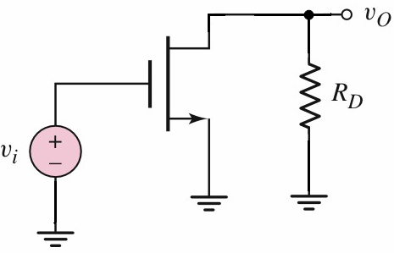
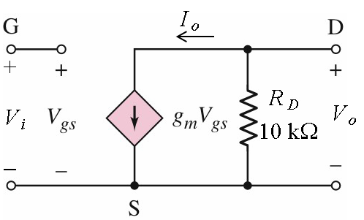
MOSFET
Basic FET Amplifiers
The MOSFET Amplifier
Example 1 – Solution
(a)
For the ac equivalent circuit, all dc voltage sources are set to zero;
(b)
Since λ = 0, the output resistance r_{o} is omitted in the small-signal equivalent circuit;

Slide 25
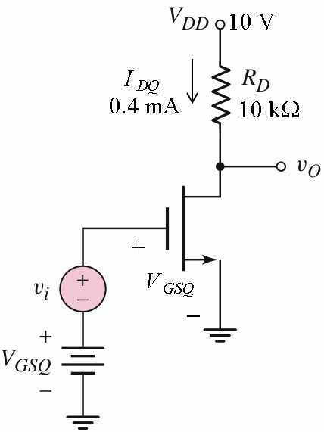
MOSFET
Basic FET Amplifiers
The MOSFET Amplifier
Example 1 – Solution (cont’d)
(c)

Slide 26
MOSFET
Basic FET Amplifiers
The MOSFET Amplifier
Example 1 – Solution (cont’d)
At the output terminal;
At the input terminal;
Substituting for V_{gs};
The small-signal voltage gain is;

Slide 27
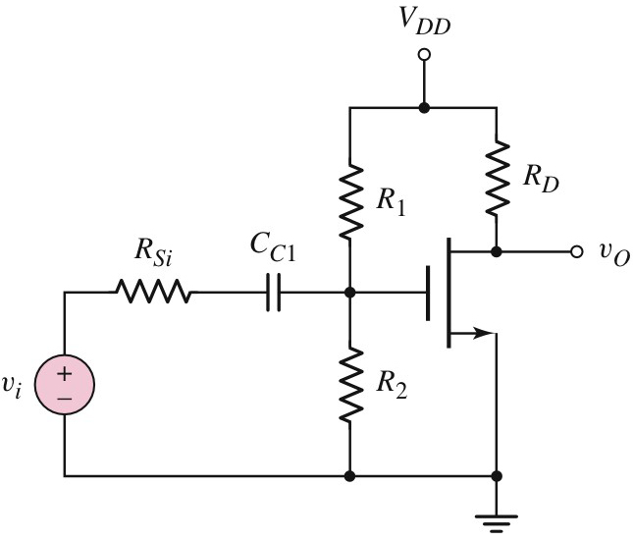
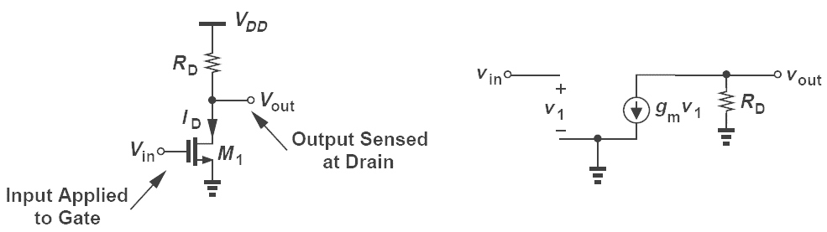
MOSFET
Basic Amplifier Configurations
Common-source
R₁ and R₂ establish the transistor biasing. C_{C1} couples the signal to the input acts as an open circuit for dc voltage. At signal frequency, this capacitor is considered as a short circuit.
The source is grounded and is common to both input and output – hence the name common-source

Slide 28
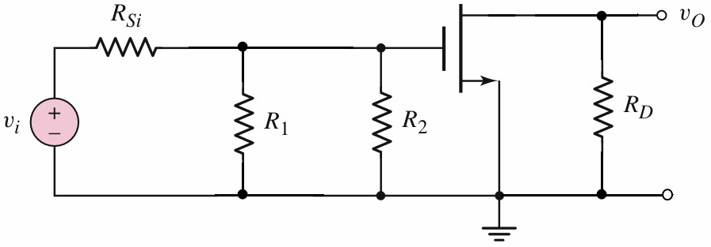
MOSFET
Basic Amplifier Configurations
Common-source
Since the coupling capacitor is considered as a short circuit at signal frequency and all dc sources are set to zero under ac condition, the ac equivalent circuit for the amplifier may drawn as follows;

Slide 29
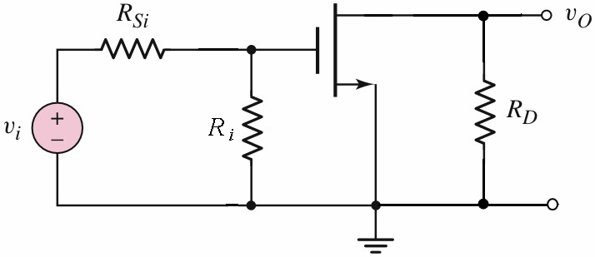
MOSFET
Basic Amplifier Configurations
Common-source
The parallel combination of R₁ and R₂ may be replaced by R_{i} where;
R_{i} is the input resistance of the amplifier.

Slide 30
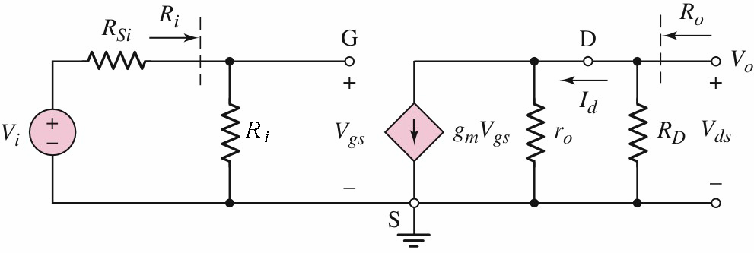
MOSFET
Basic Amplifier Configurations
Common-source
The small-signal equivalent circuit may drawn as shown below;
In the above circuit, the output resistance of the transistor, r_{o} is finite and taken into account.

Slide 31
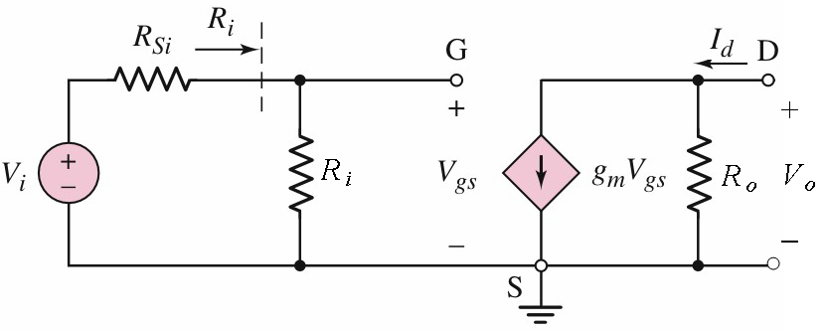
MOSFET
Basic Amplifier Configurations
Common-source
Since R_{D} and the output resistance of the transistor, r_{o} are in parallel, the small-signal equivalent circuit may be redrawn as shown below.

Slide 32
MOSFET
Basic Amplifier Configurations
Common-source
Using this equivalent circuit, at the output terminal;
At the input terminal;
Hence the voltage gain is;

Slide 33
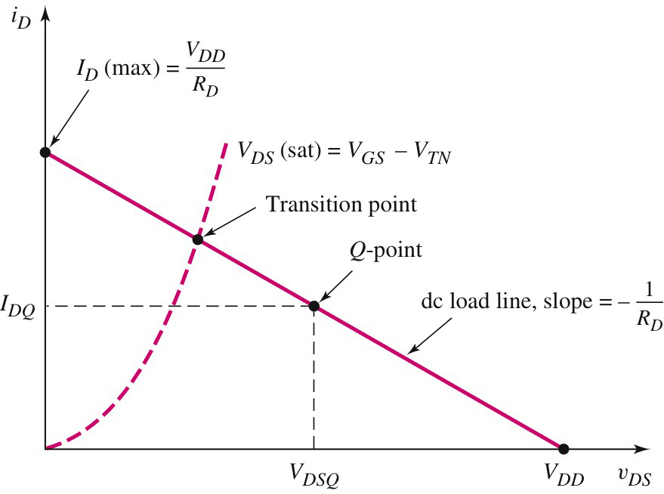
MOSFET
Basic Amplifier Configurations
Common-source
Boundary between saturation and triode region
For maximum symmetrical swing, the Q-point must be near the middle of the saturation region
Triode region
Saturation region

Slide 34
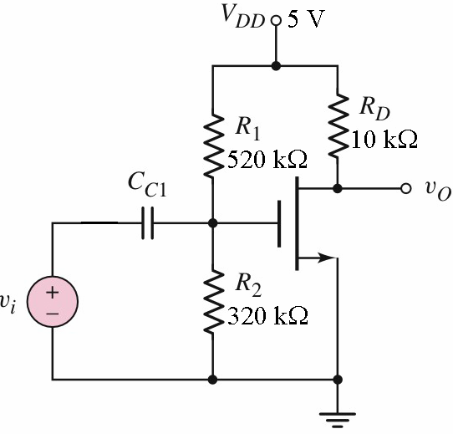
MOSFET
Basic Amplifier Configurations
Common-source
Example 1
The transistor in the figure has the following parameters;
Find the following;
(a) g_{m} and r_{o};
(b) A_{v};
(c) R_{i} and R_{o}.

Slide 35
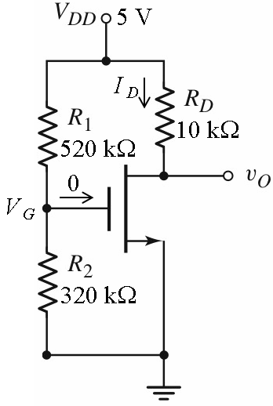
MOSFET
Basic Amplifier Configurations
Common-source
Example 1 – Solution
(a)
The circuit under dc condition

Slide 36
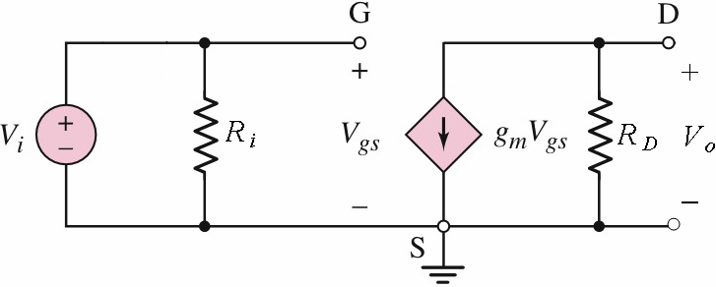
MOSFET
Basic Amplifier Configurations
Common-source
Example 1 – Solution (cont’d)
(b)

Slide 37
MOSFET
Basic Amplifier Configurations
Common-source
Example 1 – Solution (cont’d)
(c)

Slide 38
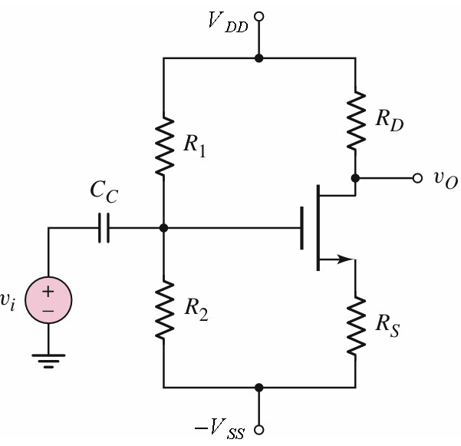
MOSFET
Basic Amplifier Configurations
Common-source with R_{S}
The source resistor R_{S} tends to stabilize the Q-point against variations in transistor parameters. However, the inclusion of this resistor reduces the amplifier gain.

Slide 39
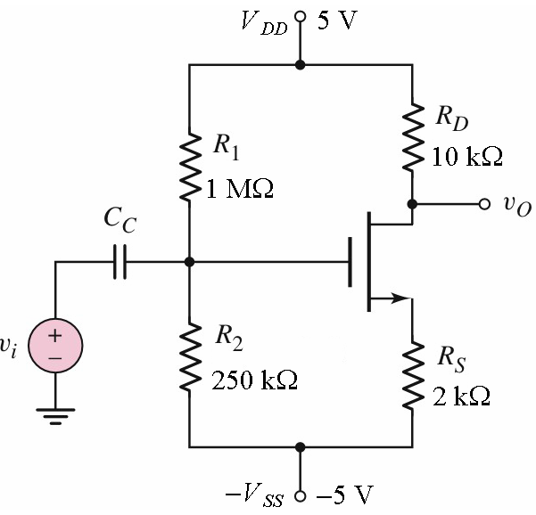
MOSFET
Basic Amplifier Configurations
Common-source with R_{S}
Example 2
The transistor in the figure has the following parameters;
(a) Determine the Q-point of the amplifier.
(b) Find the small-signal voltage gain

Slide 40
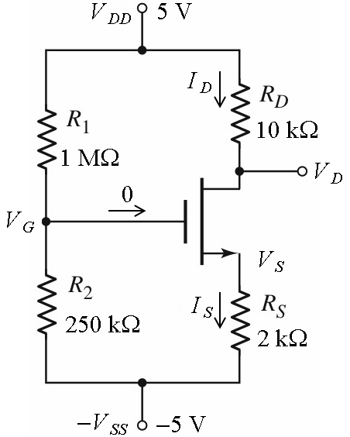
MOSFET
Basic Amplifier Configurations
Common-source with R_{S}
Example 2 – Solution
The circuit under dc condition
The gate voltage:

Slide 41
MOSFET
Basic Amplifier Configurations
Common-source with R_{S}
Example 2 – Solution (cont’d)
The circuit under dc condition
Substituting for I_{D} and rearranging, we have;
or;

Slide 42
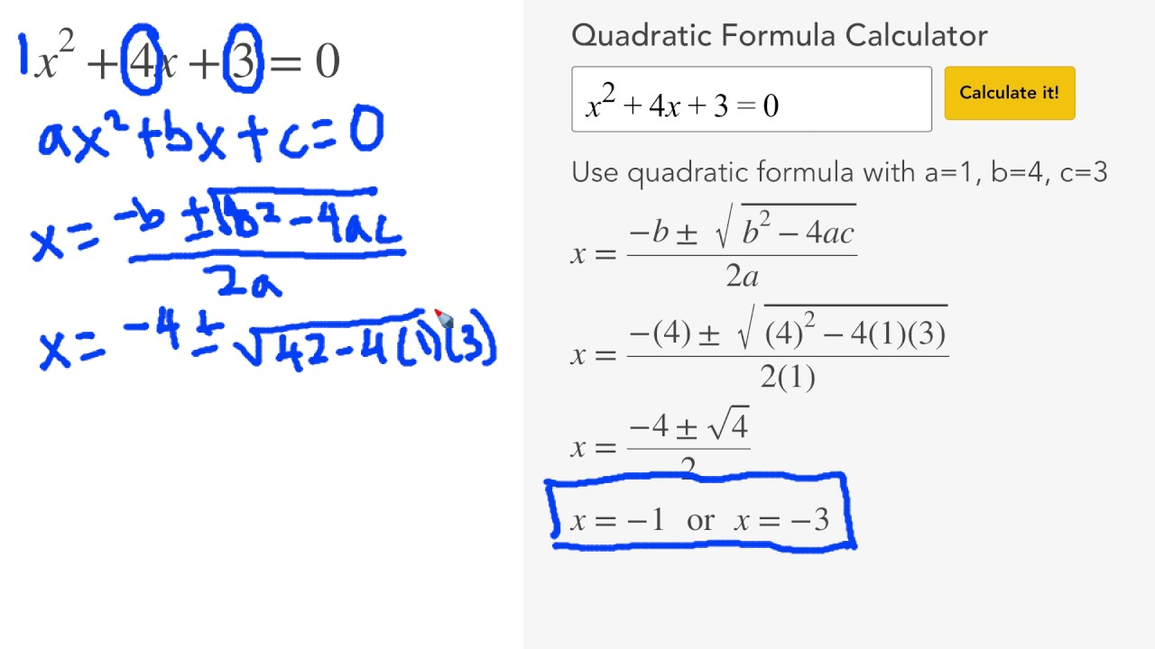

Slide 43
MOSFET
Basic Amplifier Configurations
Common-source with R_{S}
Example 2 – Solution (cont’d)
The circuit under dc condition
Solving the quadratic equation, gives us;
Substituting for V_{GS} in;
we obtain;

Slide 44
MOSFET
Basic Amplifier Configurations
Common-source with R_{S}
Example 2 – Solution (cont’d)
The circuit under dc condition

Slide 45
MOSFET
Basic Amplifier Configurations
Common-source with R_{S}
Example 2 – Solution (cont’d)
The Q-point:
The transconductance is;

Slide 46
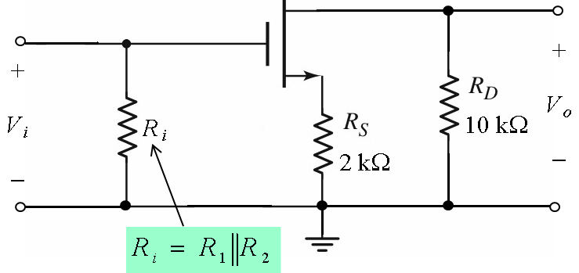
MOSFET
Basic Amplifier Configurations
Common-source with R_{S}
Example 2 – Solution (cont’d)
The ac equivalent circuit may be drawn as follows;

Slide 47
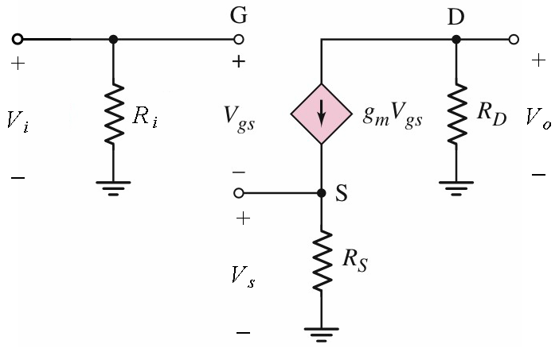
MOSFET
Basic Amplifier Configurations
Common-source with R_{S}
Example 2 – Solution (cont’d)
The small-signal equivalent circuit may be drawn as follows;

Slide 48
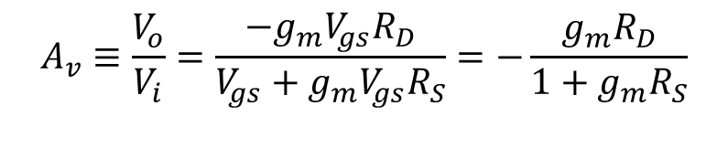
MOSFET
Basic Amplifier Configurations
Common-source with R_{S}
Example 2 – Solution (cont’d)
The small-signal voltage gain is;
$$A_{v}≡\frac{V_{o}}{V_{i}}=\frac{−g_{m}V_{gs}R_{D}}{V_{gs}+g_{m}V_{gs}R_{S}}=−\frac{g_{m}R_{D}}{1+g_{m}R_{S}}$$

Slide 49
MOSFET
Basic Amplifier Configurations
Common-source with R_{S}
Example 2 – Solution (cont’d)
Substituting values;

Slide 50
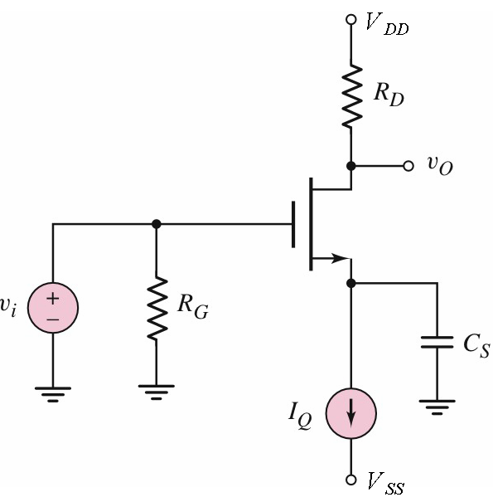
MOSFET
Basic Amplifier Configurations
Common-source with C_{S}
The transistor is biased with a constant current source, I_{Q}.
The bypass capacitor, C_{s} minimizes the loss in small-signal voltage gain but maintains the stability of the Q-point.
For small-signal analysis, C_{s} is considered as a short circuit.

Slide 51
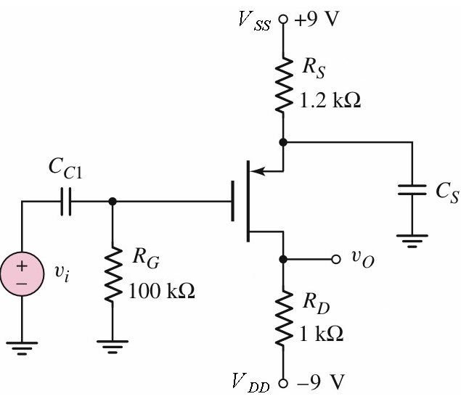
MOSFET
Basic Amplifier Configurations
Common-source with C_{S}
Example 3
The parameters for the transistor in the figure are;
(a) Determine the Q-point
(c) Calculate the small-signal voltage gain A_{v}.

Slide 52
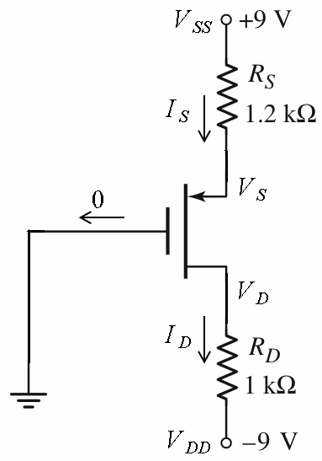
MOSFET
Basic Amplifier Configurations
Common-source with C_{S}
Example 3 – Solution
Since I_{G} is assumed to be zero, G is at the ground potential and I_{S} = I_{D}.
The circuit under dc condition

Slide 53
MOSFET
Basic Amplifier Configurations
Common-source with C_{S}
Example 3 – Solution (cont’d)
Substituting for I_{D};
The circuit under dc condition
or;
Solving the equation for V_{SG}, we obtain;

Slide 54
MOSFET
Basic Amplifier Configurations
Common-source with C_{S}
Example 3 – Solution (cont’d)
The circuit under dc condition

Slide 55
MOSFET
Basic Amplifier Configurations
Common-source with C_{S}
Example 3 – Solution (cont’d)
(a)
The circuit under dc condition
The Q-point is;

Slide 56
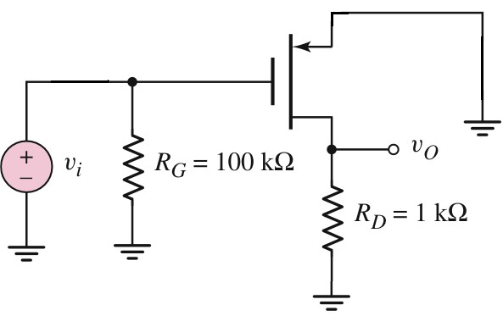
MOSFET
Basic Amplifier Configurations
Common-source with C_{S}
Example 3 – Solution (cont’d)
The ac equivalent circuit

Slide 57
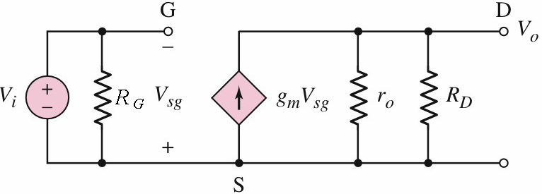
MOSFET
Basic Amplifier Configurations
Common-source with C_{S}
Example 3 – Solution (cont’d)
The small-signal equivalent circuit may drawn as follows;
Note that r_{o} is included in the equivalent circuit because the value of λ is given.

Slide 58
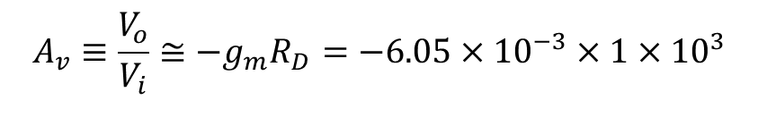
MOSFET
Basic Amplifier Configurations
Common-source with C_{S}
Example 3 – Solution (cont’d)
(b)
The small-signal voltage gain is;
$$A_{v}≡\frac{V_{o}}{V_{i}}≅−g_{m}R_{D}=−6.05×10^{−3}×1×10^{3}$$

Slide 59
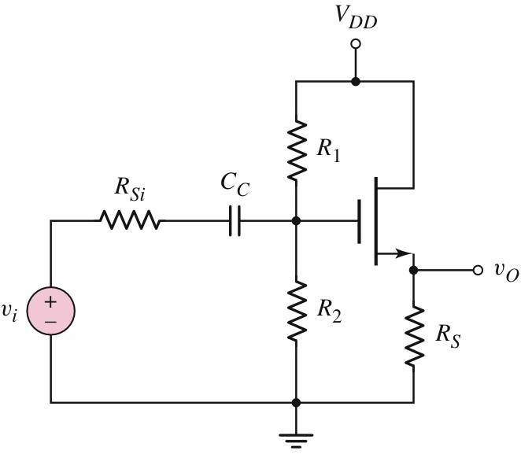
MOSFET
Basic Amplifier Configurations
Common-drain
Also known as source-follower
The output is taken from the source.
The drain is connected to V_{DD} which is the signal ground and becomes the common terminal for the input and output, hence the name common-drain.

Slide 60
MOSFET
Basic Amplifier Configurations
Common-drain
Q-point
Determined by means of DC analysis
Voltage gain, A_{v};
Input resistance, R_{i};
Output resistance, R_{o};
Determine by means of AC (small-signal) analysis

Slide 61
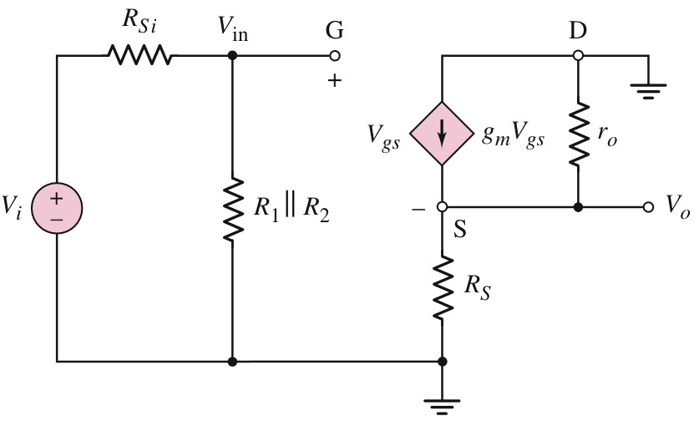
MOSFET
Basic Amplifier Configurations
Common-drain
The small-signal analysis may be performed using the following small-signal equivalent circuit.

Slide 62
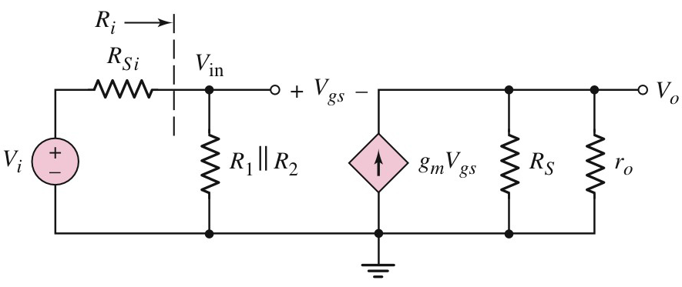
MOSFET
Basic Amplifier Configurations
Common-drain – Voltage gain A_{v}
The small-signal equivalent circuit may be redrawn as follows;

Slide 63
MOSFET
Basic Amplifier Configurations
Common-drain – Voltage gain A_{v}

Slide 64
MOSFET
Basic Amplifier Configurations
Common-drain – Voltage gain A_{v}
At the input side;
where

Slide 65
MOSFET
Basic Amplifier Configurations
Common-drain – Voltage gain A_{v}
and
Combining the two equations, gives us;
Hence;

Slide 66
MOSFET
Basic Amplifier Configurations
Common-drain – Voltage gain A_{v}
The small-signal voltage gain is;

Slide 67
MOSFET
Basic Amplifier Configurations
Common-drain – Voltage gain A_{v}
The small-signal voltage gain also can be written as;
Note that there is no phase shift

Slide 68
MOSFET
Basic Amplifier Configurations
Common-drain – Input resistance R_{i}
The input resistance of the common-drain amplifier is;

Slide 69
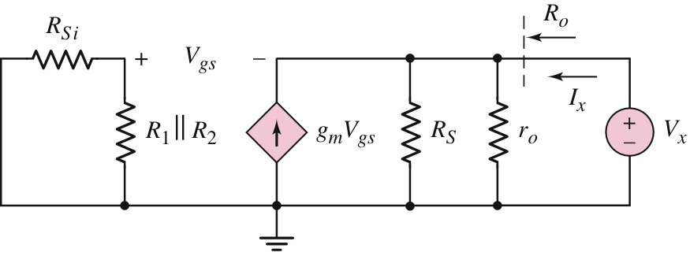
MOSFET
Basic Amplifier Configurations
Common-drain – Output resistance R_{o}
To calculate the output resistance, set all the independent voltage source to zero and apply a test voltage V_{x} at the output terminal as shown below;

Slide 70
MOSFET
Basic Amplifier Configurations
Common-drain – Output resistance R_{o}
Applying KCL at this node gives the equation

Slide 71
MOSFET
Basic Amplifier Configurations
Common-drain – Output resistance R_{o}
Since there is no current in the input side, we have;
Substituting for V_{gs}, we have;

Slide 72
MOSFET
Basic Amplifier Configurations
Common-drain – Output resistance R_{o}
Or;
The output resistance is;

Slide 73
MOSFET
Basic Amplifier Configurations
Common-drain – Output resistance R_{o}
Therefore;

Slide 74
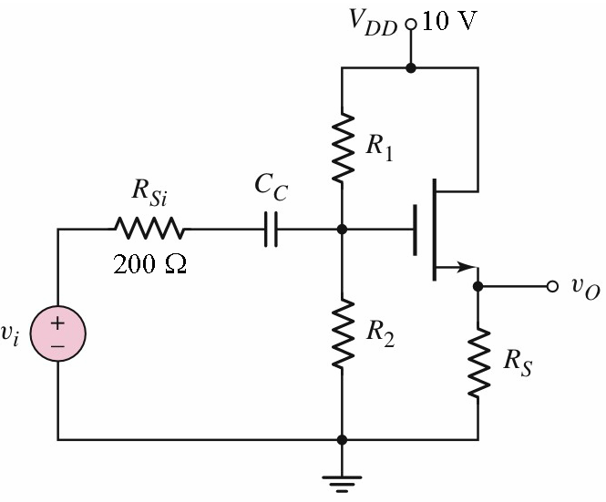
MOSFET
Basic Amplifier Configurations
Common-drain
Example 4
The transistor parameters in the figure are as follows;
Design the circuit such that;
Determine the small-signal voltage gain

Slide 75
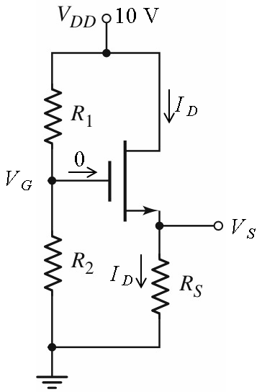
MOSFET
Basic Amplifier Configurations
Common-drain
Example 4 – Solution
The dc equivalent circuit;

Slide 76
MOSFET
Basic Amplifier Configurations
Common-drain
Example 4 – Solution (cont’d)
The dc equivalent circuit;

Slide 77
MOSFET
Basic Amplifier Configurations
Common-drain
Example 4 – Solution (cont’d)
The dc equivalent circuit;

Slide 78
MOSFET
Basic Amplifier Configurations
Common-drain
Example 4 – Solution (cont’d)
The dc equivalent circuit;
If

Slide 79
MOSFET
Basic Amplifier Configurations
Common-drain
Example 4 – Solution (cont’d)
The dc equivalent circuit;
If
Unrealistic – negative V_{GS}.

Slide 80
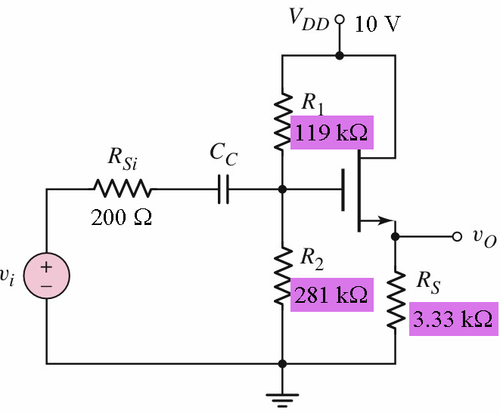
MOSFET
Basic Amplifier Configurations
Common-drain
Example 4 – Solution (cont’d)
The circuit with all the designed values;

Slide 81
MOSFET
Basic Amplifier Configurations
Common-drain
Example 4 – Solution (cont’d)
The transconductance is;
The output resistance of the transistor;

Slide 82
MOSFET
Basic Amplifier Configurations
Common-drain
Example 4 – Solution (cont’d)
The small-signal voltage of the amplifier is;

Slide 83
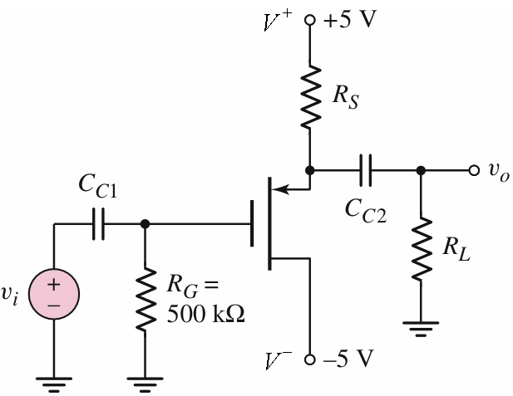
MOSFET
Basic Amplifier Configurations
Common-drain
Example 5
The transistor in the figure has the following parameters;
Design the circuit such that I_{DQ} = 3 mA.
Determine the open-circuit small-signal voltage gain and output resistance
What value of R_{L} will result in a 10% reduction in gain?

Slide 84
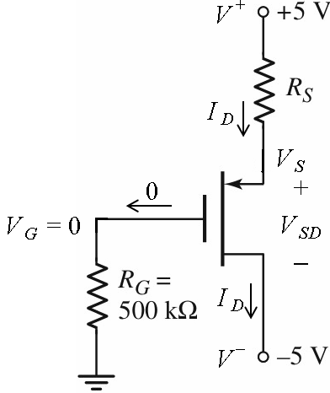
MOSFET
Basic Amplifier Configurations
Common-drain
Example 5 – Solution
The circuit under dc condition
Since I_{D} = 3 mA;
Because G is at ground potential, we have;
The equation for the drain current is;

Slide 85
MOSFET
Basic Amplifier Configurations
Common-drain
Example 5 – Solution (cont’d)
Substituting values;
Or;
The above equation gives us two values;
or

Slide 86
MOSFET
Basic Amplifier Configurations
Common-drain
Example 5 – Solution (cont’d)
For
(unrealistic because V_{SG} < |V_{TP}|
For
(acceptable)

Slide 87
MOSFET
Basic Amplifier Configurations
Common-drain
Example 5 – Solution (cont’d)
The transconductance is;

Slide 88
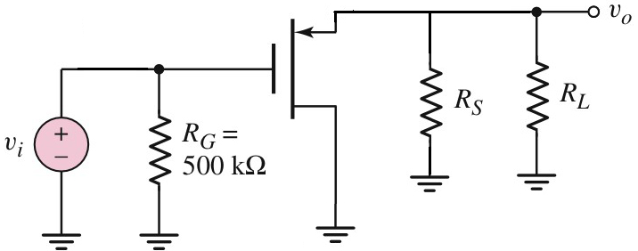
MOSFET
Basic Amplifier Configurations
Common-drain
Example 5 – Solution (cont’d)
The ac equivalent circuit is as follows;

Slide 89
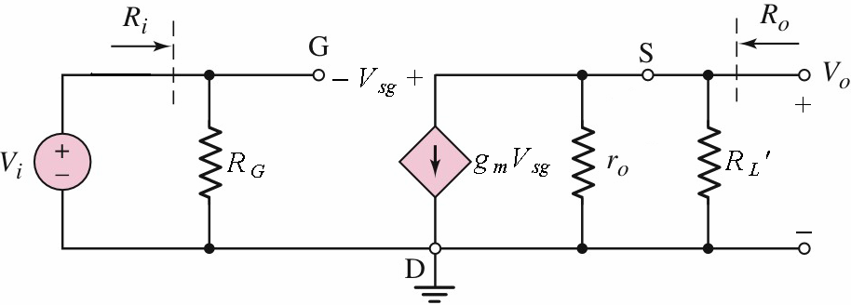
MOSFET
Basic Amplifier Configurations
Common-drain
Example 5 – Solution (cont’d)

Slide 90
MOSFET
Basic Amplifier Configurations
Common-drain
Example 5 – Solution (cont’d)

Slide 91
MOSFET
Basic Amplifier Configurations
Common-drain
Example 5 – Solution (cont’d)
(As calculated previously )
(Since R_{L} = ∞ − open circuit)

Slide 92
MOSFET
Basic Amplifier Configurations
Common-drain
Example 5 – Solution (cont’d)
The open-circuit small-signal voltage gain is;
The voltage gain after a reduction of 10% is;

Slide 93
MOSFET
Basic Amplifier Configurations
Common-drain
Example 5 – Solution (cont’d)
Substituting for A_{v} in the equation;
we have;

Slide 94
MOSFET
Basic Amplifier Configurations
Common-drain
Example 5 – Solution (cont’d)
Substituting the value for g_{m} gives us;
Solving the above equation, we obtaine;
This equation may be written as;

Slide 95
MOSFET
Basic Amplifier Configurations
Common-drain
Example 5 – Solution (cont’d)
Or;
Substituting values;

Slide 96
MOSFET
Basic Amplifier Configurations
Common-drain
Example 5 – Solution (cont’d)
Solving the equation for RL gives us;

Slide 97
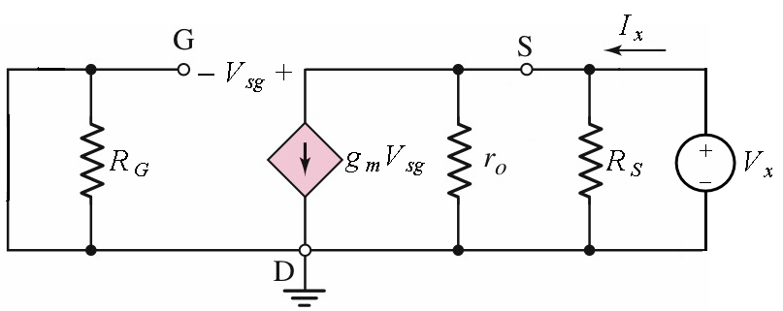
MOSFET
Basic Amplifier Configurations
Common-drain
Example 5 – Solution (cont’d)
Using the equivalent circuit above, the output resistance R_{o} is given by the expression;

Slide 98
MOSFET
Basic Amplifier Configurations
Common-drain
Example 5 – Solution (cont’d)
Substituting values;

Slide 99
MOSFET
Basic Amplifier Configurations
Common-drain
Example 5 – Solution (cont’d)
The output resistance is;

Slide 100
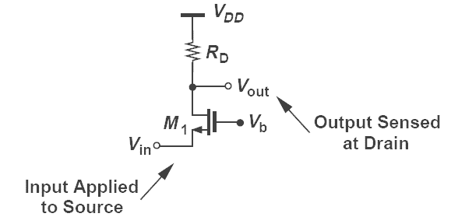
MOSFET
Basic Amplifier Configurations
Common-gate
The input signal is applied to the source and gate terminal is grounded. The output is taken between the drain and gate terminals. The gate is therefore common to both the input and output and hence the name “common-gate”

Slide 101
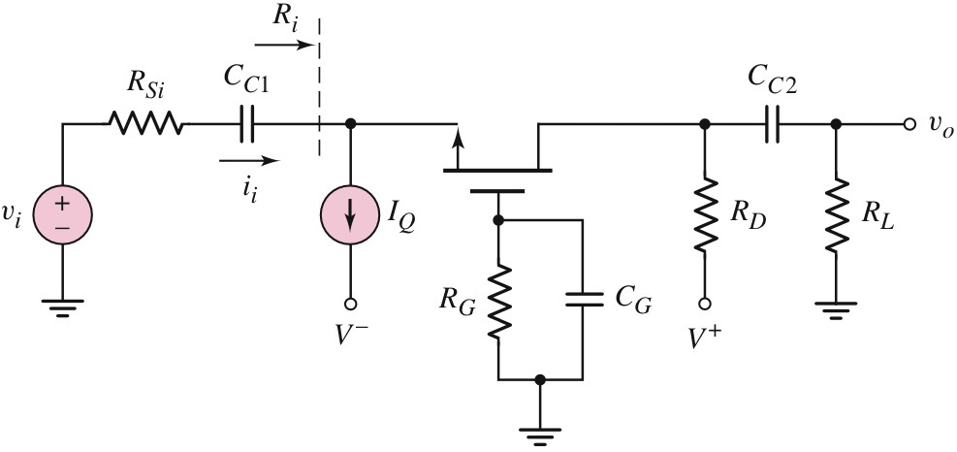
MOSFET
Basic Amplifier Configurations
Common-gate
C_{C1} and C_{C2} are the coupling capacitors for input and output respectively. In the following figure, the bias current is obtained from the current source I_{Q}.

Slide 102
MOSFET
Basic Amplifier Configurations
Common-gate
The dc analysis is the same as that of previous configurations.

Slide 103

MOSFET
Basic Amplifier Configurations
Common-gate – small-signal voltage gain
The gains can be determined using the following equivalent circuit;

Slide 104
MOSFET
Basic Amplifier Configurations
Common-gate – small-signal voltage gain
Applying KVL at the input, we obtain;
Substituting for I_{i}, we obtain;

Slide 105
MOSFET
Basic Amplifier Configurations
Common-gate – small-signal voltage gain
Re-arranging, gives us;

Slide 106
MOSFET
Basic Amplifier Configurations
Common-gate – small-signal voltage gain
Substituting for V_{gs} in the expression for V_{o}, we obtain;
The small-signal voltage gain is;

Slide 107
MOSFET
Basic Amplifier Configurations
Common-gate – input resistance
Since;
From the equivalent circuit;
the input resistance becomes;

Slide 108
MOSFET
Basic Amplifier Configurations
Common-gate – output resistance
The output resistance may be found by setting V_{i} = 0

Slide 109

MOSFET
Basic Amplifier Configurations
Common-gate – output resistance
When V_{i} is set to zero;
which only holds if

Slide 110
MOSFET
Basic Amplifier Configurations
Common-gate – output resistance
When V_{gs} = 0, the controlled current source g_{m}V_{gs} is open

Slide 111

MOSFET
Basic Amplifier Configurations
Common-gate – output resistance
The equivalent circuit becomes as shown below;
Hence the output resistance is;

Slide 112

MOSFET
Basic Amplifier Configurations
Common-gate
Example 6
The transistor parameters in the following figure are;
(a) Draw the small-signal equivalent
(b) Determine the small-signal voltage gain A_{v}.
(c) Find the input resistance R_{i}.

Slide 113

MOSFET
Basic Amplifier Configurations
Common-gate
Example 6 – Solution
DC analysis
May be performed using the dc equivalent circuit shown.

Slide 114
MOSFET
Basic Amplifier Configurations
Common-gate
Example 6 – Solution (cont’d)
From the dc equivalent circuit;
Rearranging, we have;

Slide 115
MOSFET
Basic Amplifier Configurations
Common-gate
Example 6 – Solution (cont’d)
Substituting for I_{D};
or;
Solving the equation, we have;

Slide 116
MOSFET
Basic Amplifier Configurations
Common-gate
Example 6 – Solution (cont’d)
The transconductance is;

Slide 117

MOSFET
Basic Amplifier Configurations
Common-gate
Example 6 – Solution (cont’d)
The ac equivalent circuit is as follows;

Slide 118

MOSFET
Basic Amplifier Configurations
Common-gate
Example 6 – Solution (cont’d)
Replacing the transistor with its small-signal model, we have the following circuit;

Slide 119
MOSFET
Basic Amplifier Configurations
Common-gate
Example 6 – Solution (cont’d)

Slide 120
MOSFET
Basic Amplifier Configurations
Common-gate
Example 6 – Solution (cont’d)
•
The small-signal voltage gain is

Slide 121
MOSFET
Basic Amplifier Configurations
Common-gate
Example 6 – Solution (cont’d)
Substituting values;

Slide 122

MOSFET
Basic Amplifier Configurations
Common-gate
Example 6 – Solution (cont’d)
The input resistance is;

